Slide 1
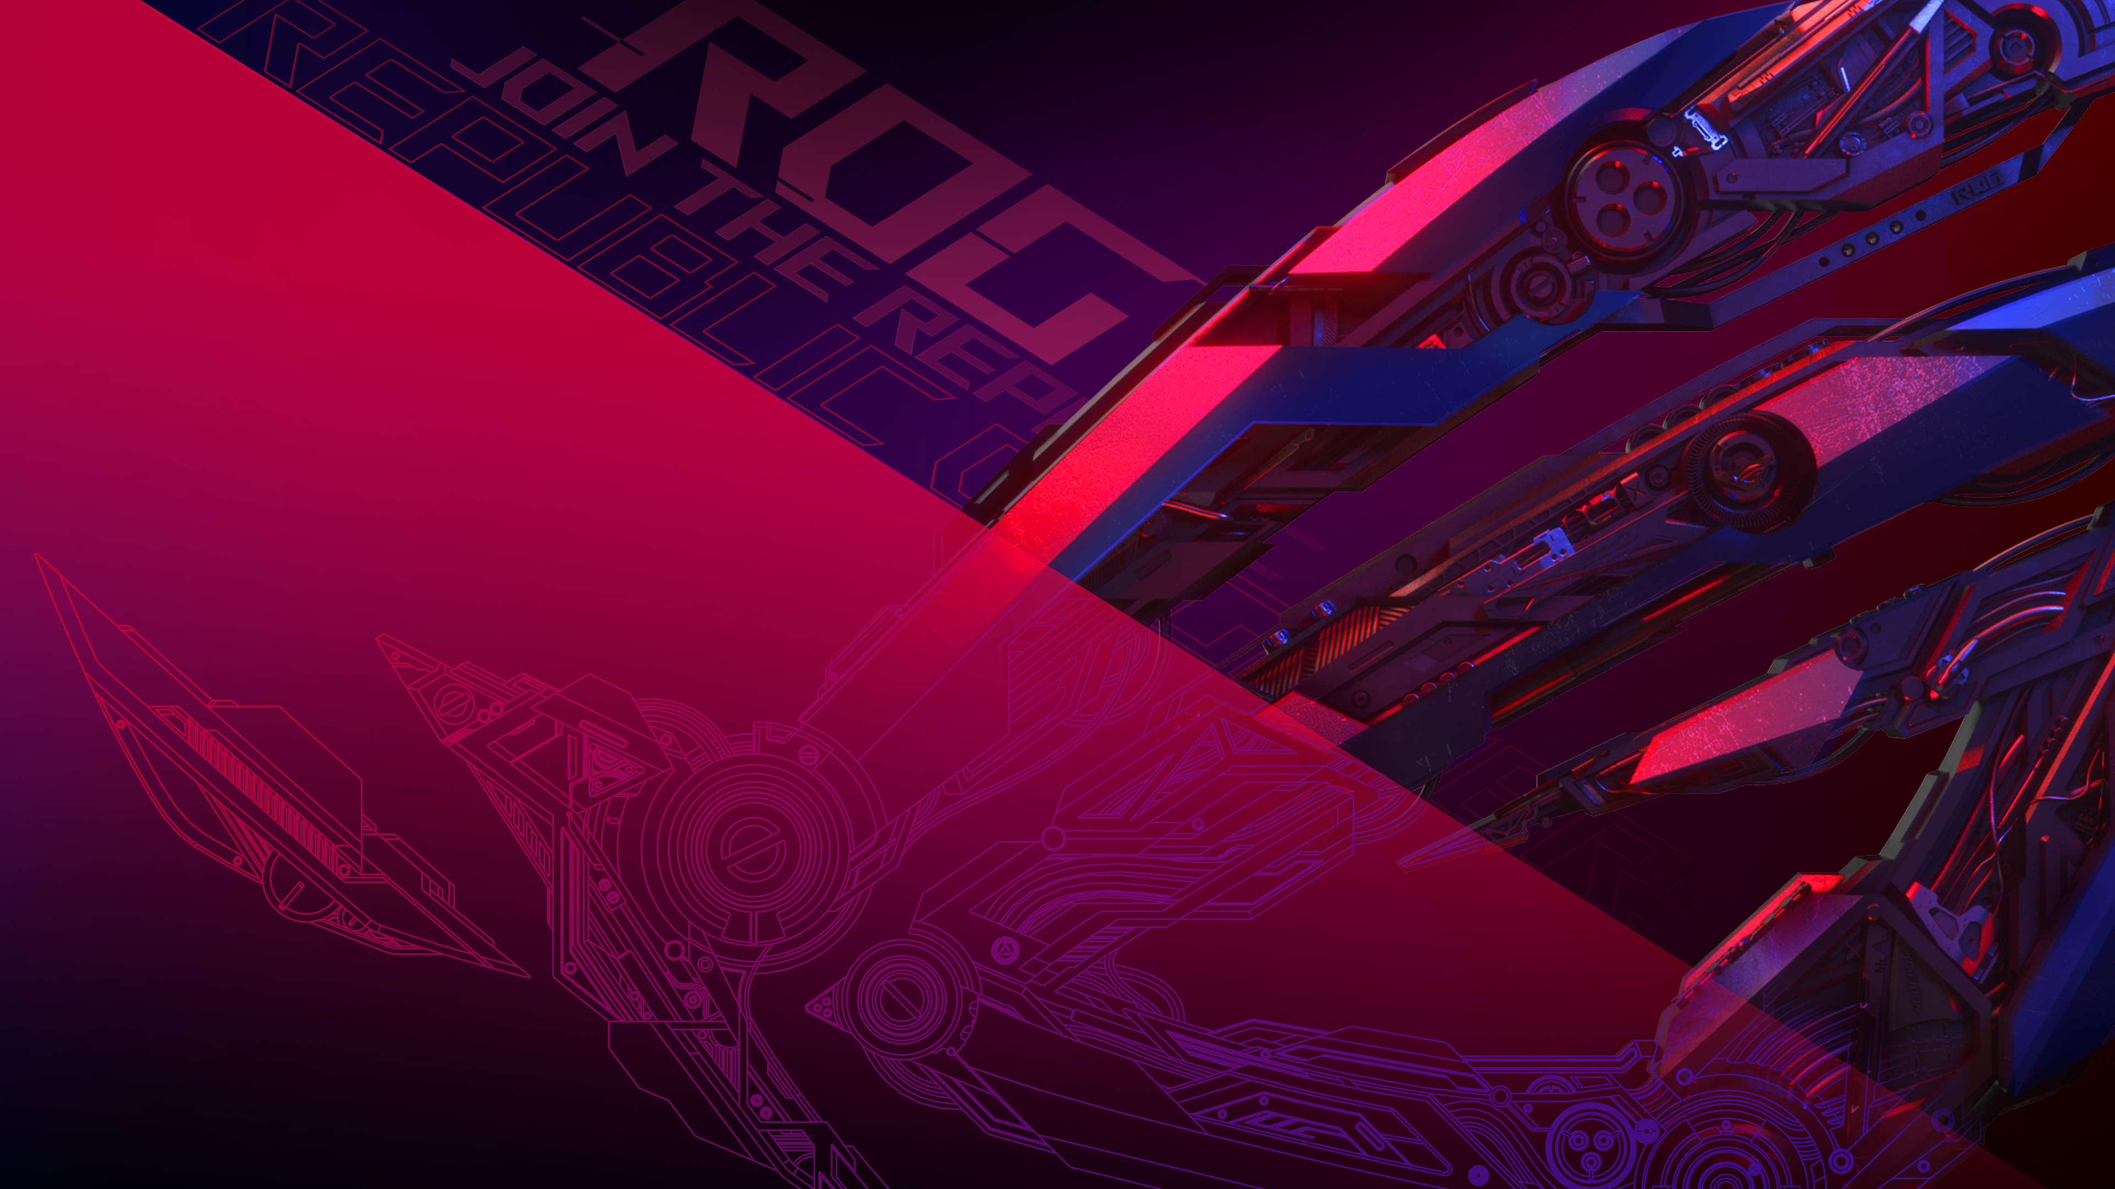
ROG STRIX 2023 launch
ROG STRIX CAMPAIGN
ACEC

Slide 2

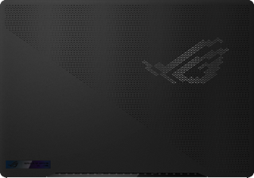
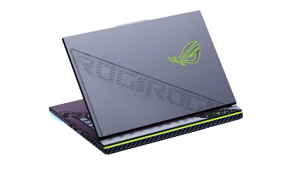
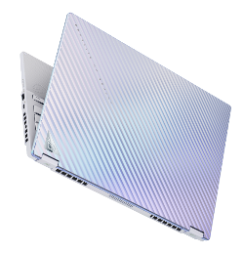
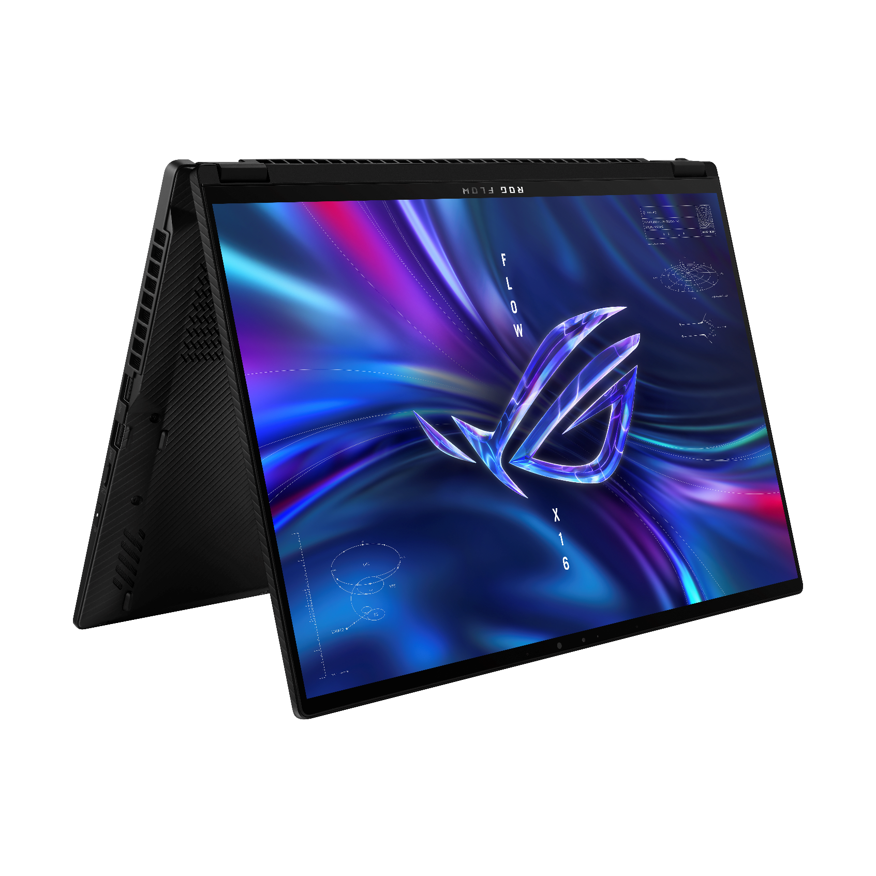
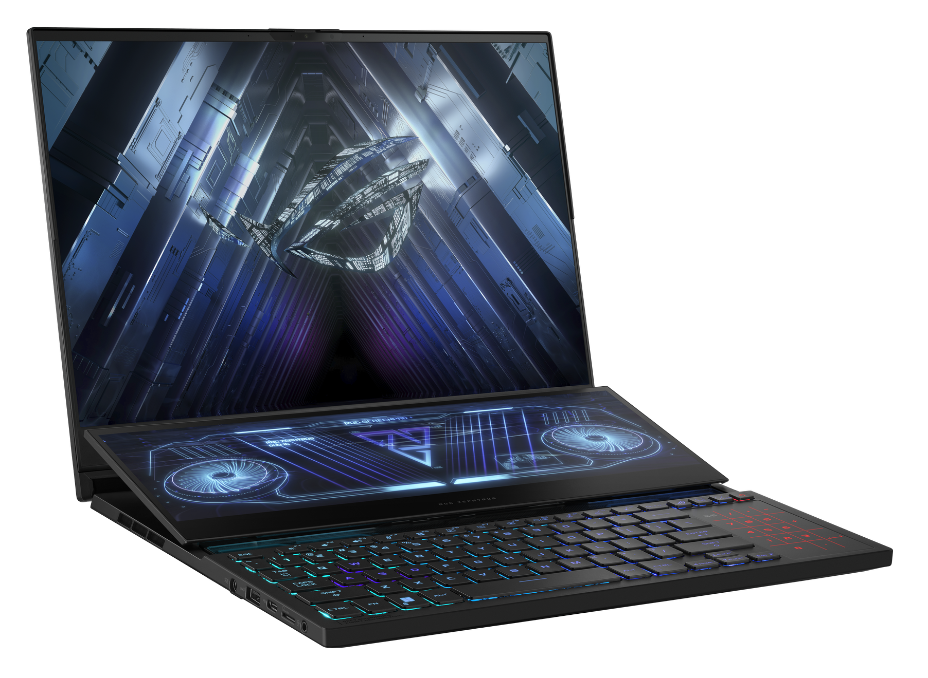
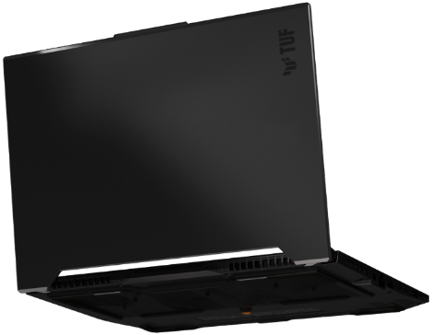
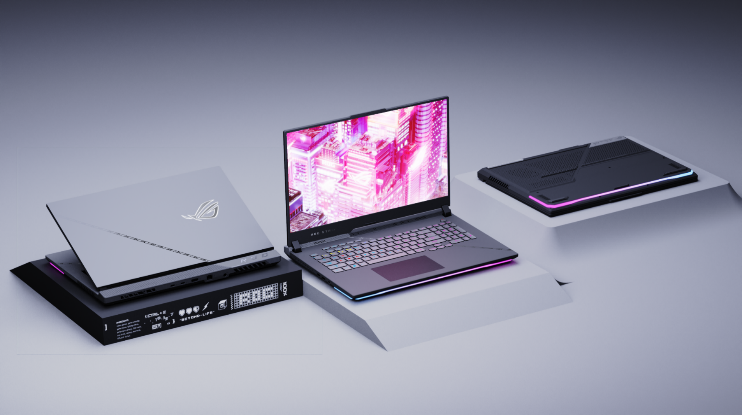
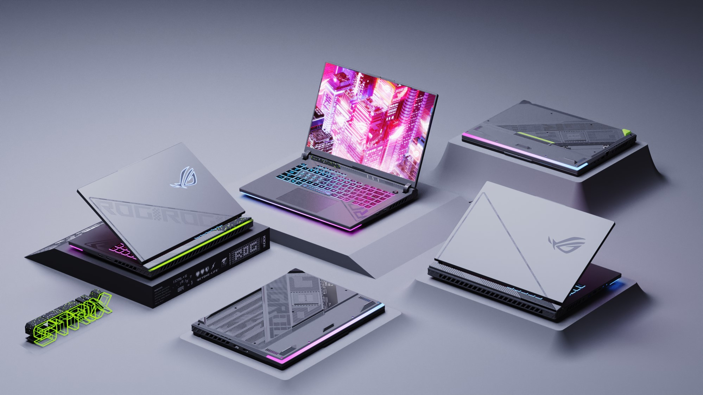
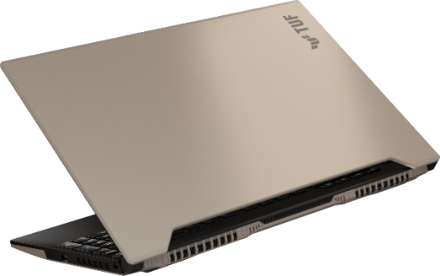
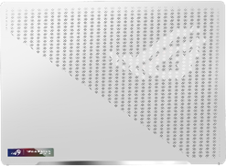
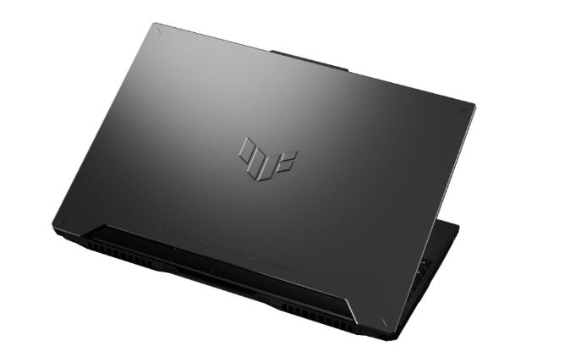
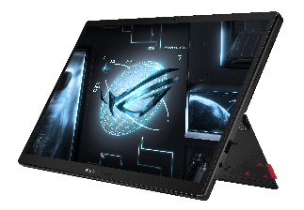
2023 Product Focus
Zephyrus
Strix
FLOW
ASUS TUF Gaming
The solid leader
in thin & light category
Stylish Thin & Light Design with Uncompromised Performance
Upgraded thermal design; AniMe Matrix™ on 16” model; new 14” ROG Nebula HDR mini LED
ROG core gaming competence
Mobile Gaming Workstation
Powerful 175W next gen GPUs x upgraded thermal design x new 18” big Nebula Display
Expand to new territory with 2 in 1 innovation
The Most Powerful 2-in-1
Brand new chassis design;
new fashion collaboration
Main volume driver
Durable & Trustworthy
First A+A TUF Gaming; premium 16” display now on TUF product line
2023 : The year of STRIX
Focus on the marketing communications of the premium product innovations :
Maxed out performance, brand new outlook design, ROG Intelligent Cooling & Nebula display
Notes:
Gaming Partnership & ACG Culture Enhancement

Slide 3
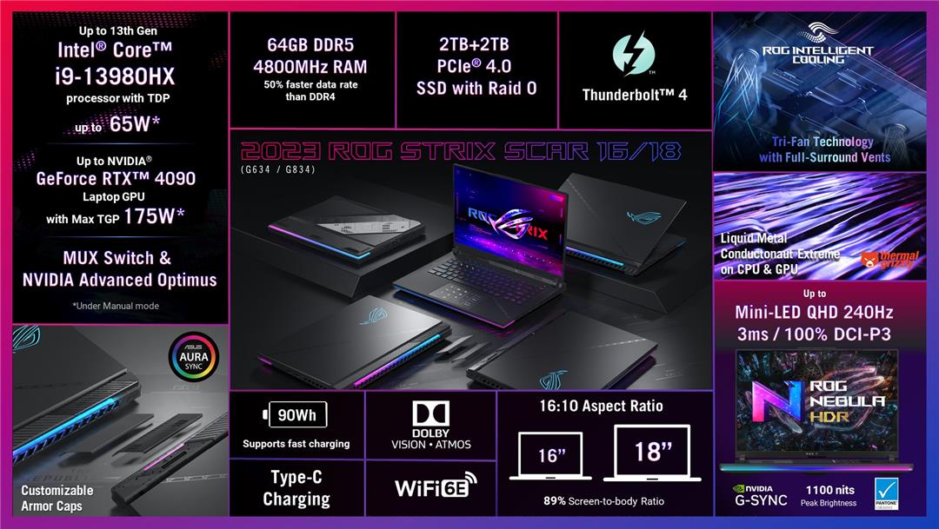
1
2
3

Slide 4
Campaign Structure
PLANNING
Project Schedule
June
TBD | TBD | TBD | TBD
Implementation Date
TBD
Execution by vertical
Detail Marketing Flow
Flow adaptation
Campaign execution
PR&Influencers (Tech specialized media and Hard Gamers Influencer)
Digital (Media buy 100% AW)
Social (Disruptive & Content differentiation – Interaction)
POS (POP and exhibition)
Events (Media gathering)

Slide 5




PR Strategy
LAUNCH
SUSTAIN
Media gathering (2 weeks in advance) focused on technology, gaming and trend sources
Media gathering list of media confirmed to the launch event
Press release
To be held in june (date to be defined).
Second wave of media reviews
Media content focused on product features:
ROG nebula display
ROG inteligent cooling
Performance
June/ july

Slide 6
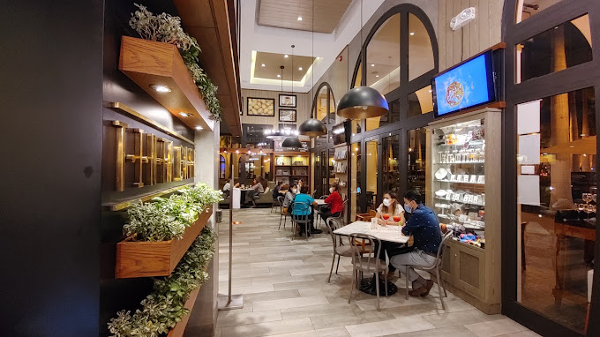
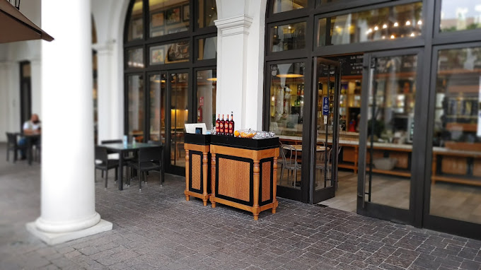
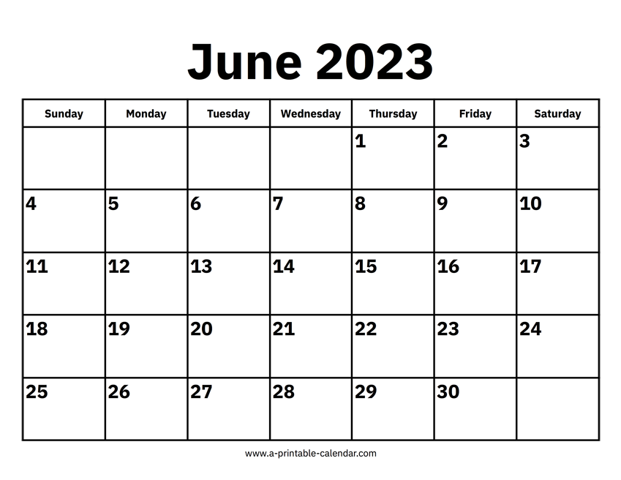
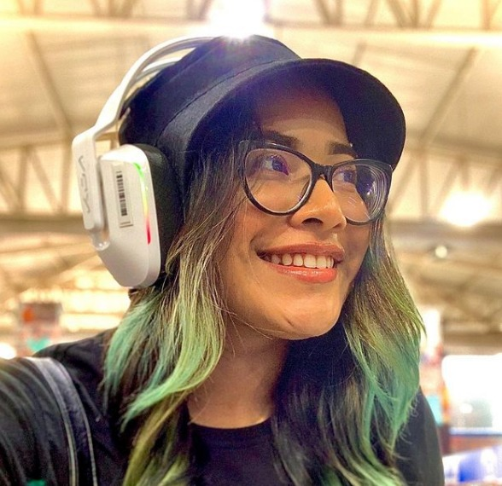
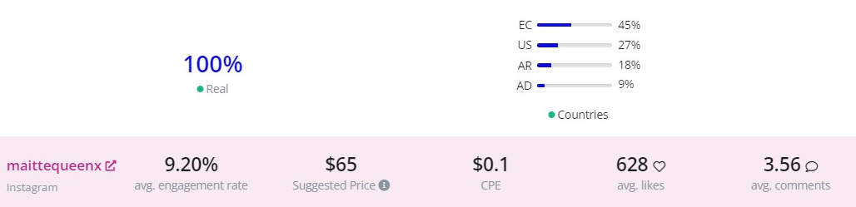
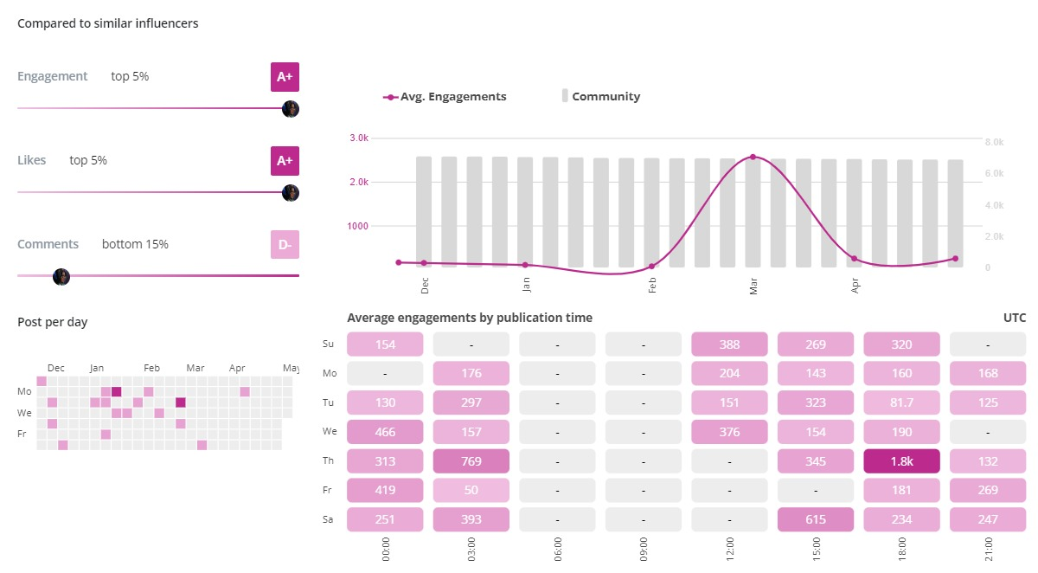
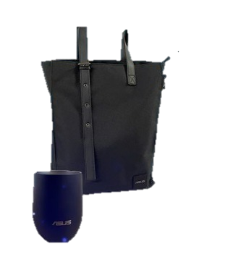
PR Media Gathering / influencers
WHEN
WHERE
Influencers
MAITTEQUEENX
6.8K
En negociaciòn* acciones*
PAX
LIST
Teleamazonas
Ecuavisa
El Universo
Expreso
Forbes
El Comercio*
La 99 Radio*
Republica techno*
TC Televisión
Asistencia virtual*
18 people
6/8 medios
1 Influencer
3 ASUS
8 Point
AGENDA
GIVEAWAY*
9am Desayuno de bienvenida
9:30 am Product
10:00 am Q&A
10:30 Despedida

Slide 7
DIGITAL
CAMPAIGN STRATEGY
AWARENESS – 40%
CONSIDERATION – 30%
CONVERSION – 30%
KEY Message
“The Pinnacle of Performance”
“The new ROG Strix with nebula display, intelligent cooling and Intel 13th gen CPU ”
“The new ROG Strix buy now!”
Target Audience
20 to 55 years / M+F
Interest:
Gaming / Video games
Technology
High performance computers
Creators
Innovation
20 to 55 years / M+F
Interest (Similar to Awareness)
Remarketing from Awareness + Lookalike
20 to 55 years / M+F
Interest (Similar to Awareness)
Remarketing from Awareness + Lookalike
Landing page
Product Page – ASUS Site + Point
Product WTB (Point)
ASUS WTB Page (Point)
CTA
“Know more”
“Know more”
“Buy Now”
Medias
DV360 / YouTube / Facebook & Instagram/SEM
DV360 / YouTube / Facebook & Instagram/SEM
DV360 / Facebook & Instagram/ SEM

Slide 8







DIGITAL EXECUTION (June)
VEHICLE
WHAT
WHERE TO BUY
Paid media/SEM
Carrousel
Banners
Video
ASUS/ROG.com
Banners
Video Unboxing
Social Media (G834)
Video Product usage
Carrousel

Slide 9
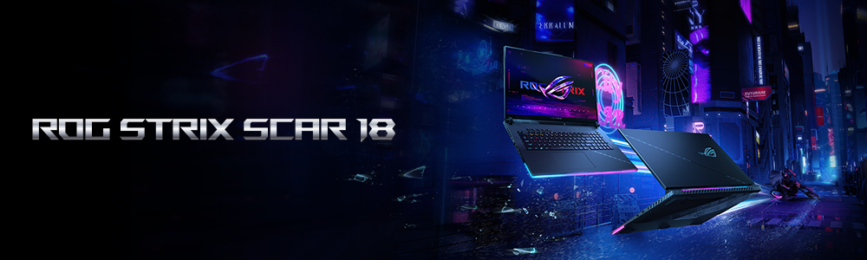
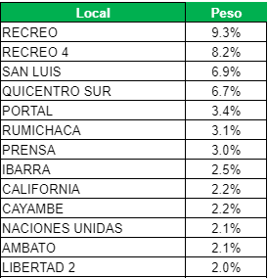
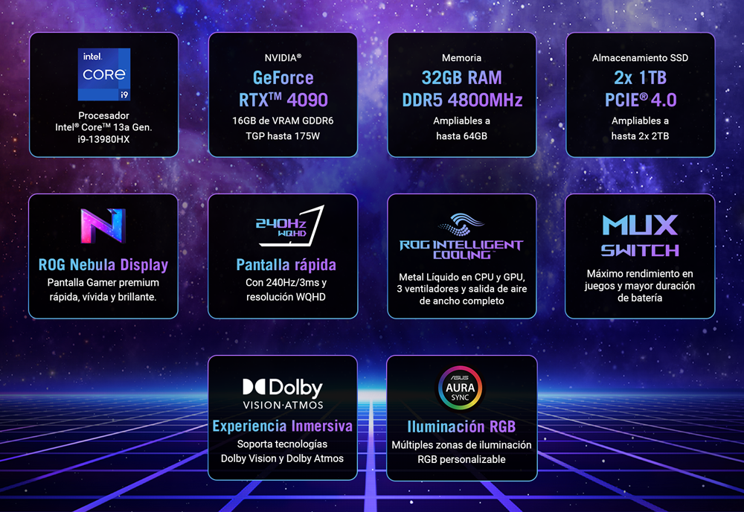
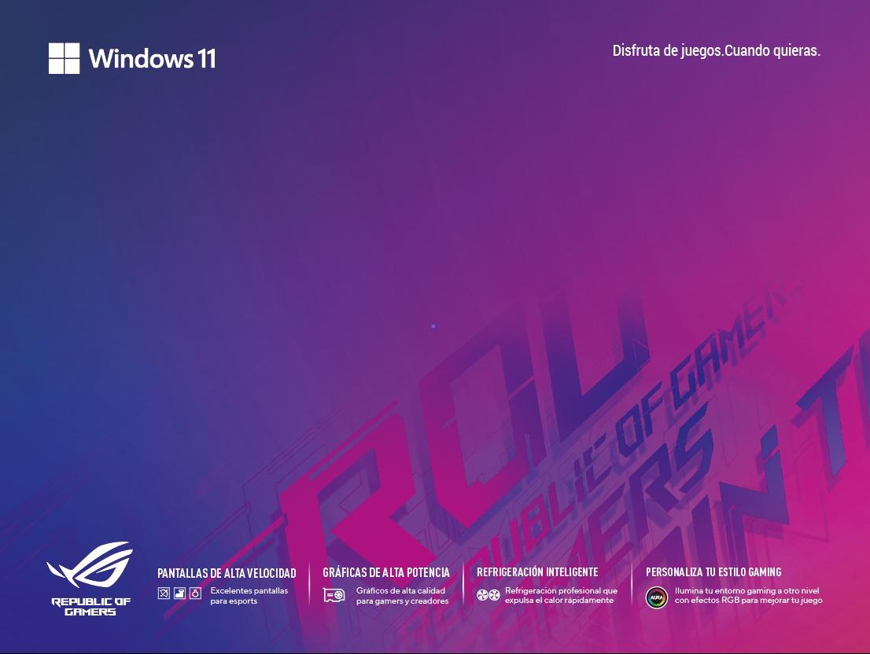
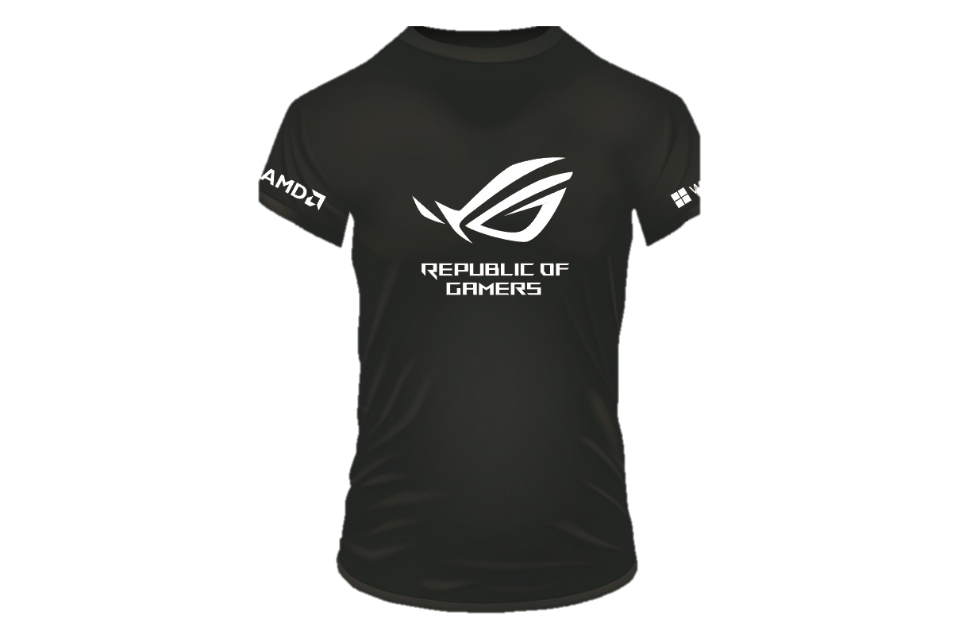
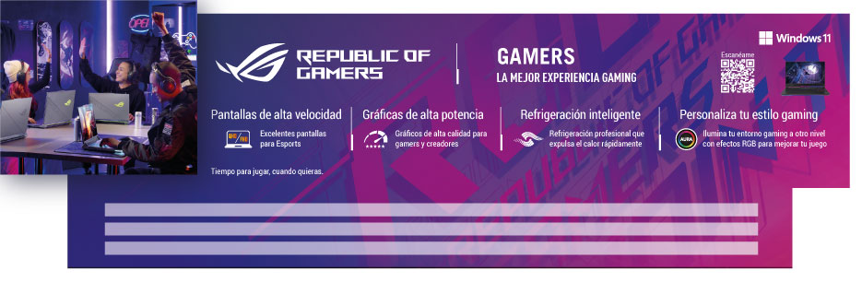
OFFLINE/ONLINE
Online
Offline
PRODUCT BANNER
POS Implementation
RICH MEDIA
KEY SELLING POINTS
MANTELETA
UNIFORM /MERCHANDISING ROG
Toppers

Slide 10
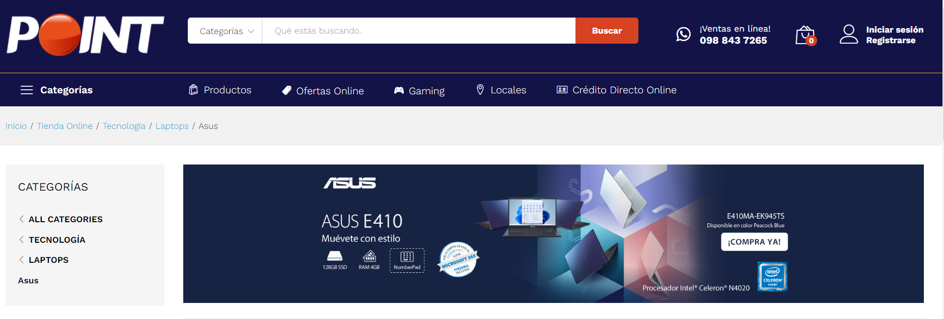
POINT CO -MARKETING
SEO/SEM
Position Launch Strix as an innovation in Google.
30%
Site Visib.
Always On in Banner Home/Banner Category. Special Dates.
30%
Social Media
Youtube is the focus for social media.Best Traffic to the site.
25%
CRM
High price ticket purchase.
15%

Slide 11
¡Thank you!

